Slide 1
Introduction to course
Ms. Tran Huyen Trang M.Ed
trangth@hanu.edu.vn
English Department
Hanoi University

Slide 2

Course Information -Speaking + Integrated skills
DURATION: 12 WEEKS
Midterm test: week 6
Final test: week 12
MATERIALS:
Chase, B. T., &amp; Johannsen, K. L. (2024). Pathways: Listening, speaking, and critical thinking 1 (3rd ed.). National Geographic Learning.
ASSESSMENT LEVEL: A2 Speaking:
- Participation: 10%
- Progress test: 30% (online via google form)
- Final test: 60%

Slide 3
Week | Speaking + Integrated skills
1 | Introduction to course - Unit 1
2 | Unit 2
3 | Unit 3
4 | Unit 4
5 | Unit 5
6 | Revision for the progress assessment
7 | Progress Test
8 | Unit 6
9 | Unit 7
10 | Unit 8
11 | Unit 9
12 | Unit 10 + revision for final test
 | Final Exam

Slide 4
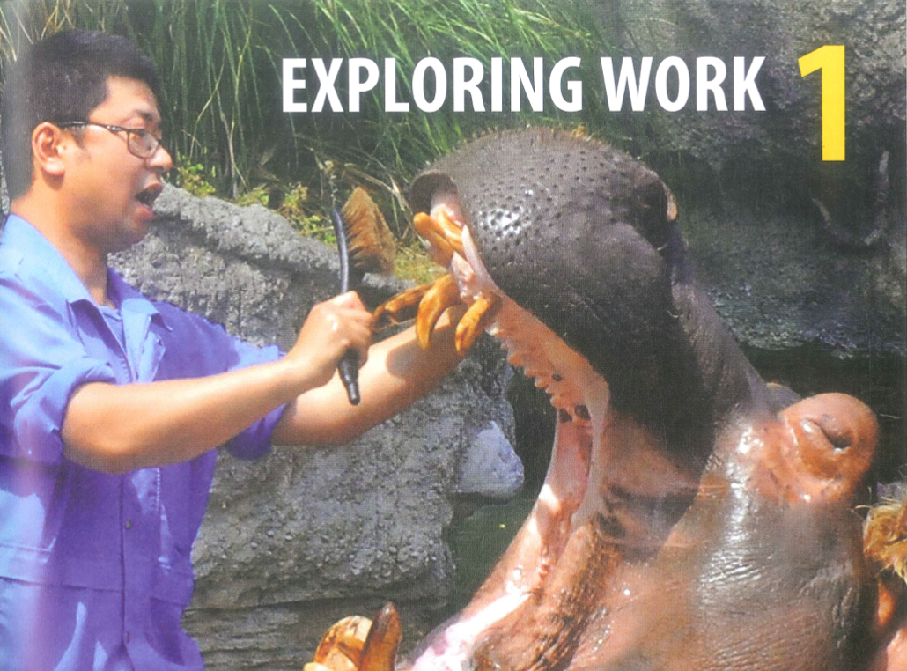

Slide 5
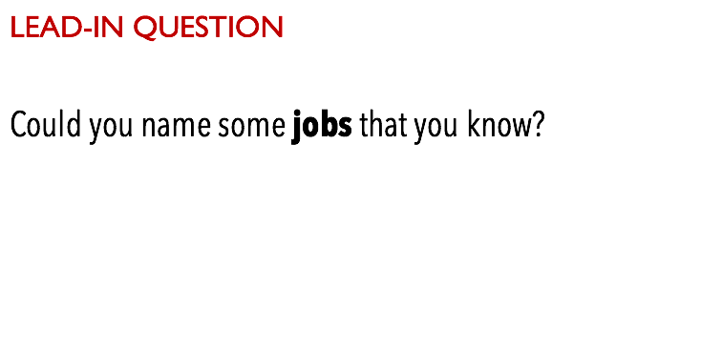

Slide 6
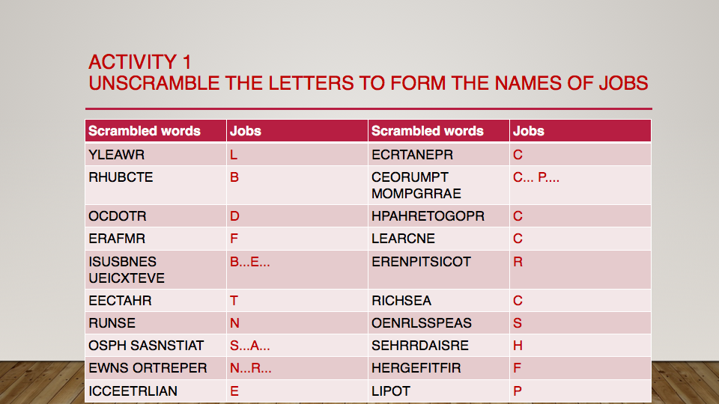
R
P

Slide 7
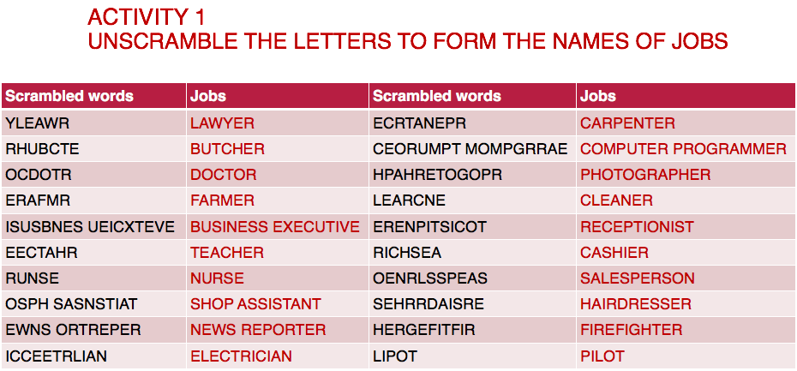

Slide 8
Activity 2 - complete the sentences with the names of jobs
A .................................................. works in a salon and cuts people's hair.
A .................................................. works in a school and teaches students.
A ........................................ works in a surgery and finds out why a person is sick.
A ............................................ works in a hospital and looks after sick people.
A .............................................. helps people when they come into a building.
A ................................................................. deals with customers in a shop.
A ........................................................ helps people with legal problems.
A ........................................... works in a building and keeps it clean and tidy.

Slide 9
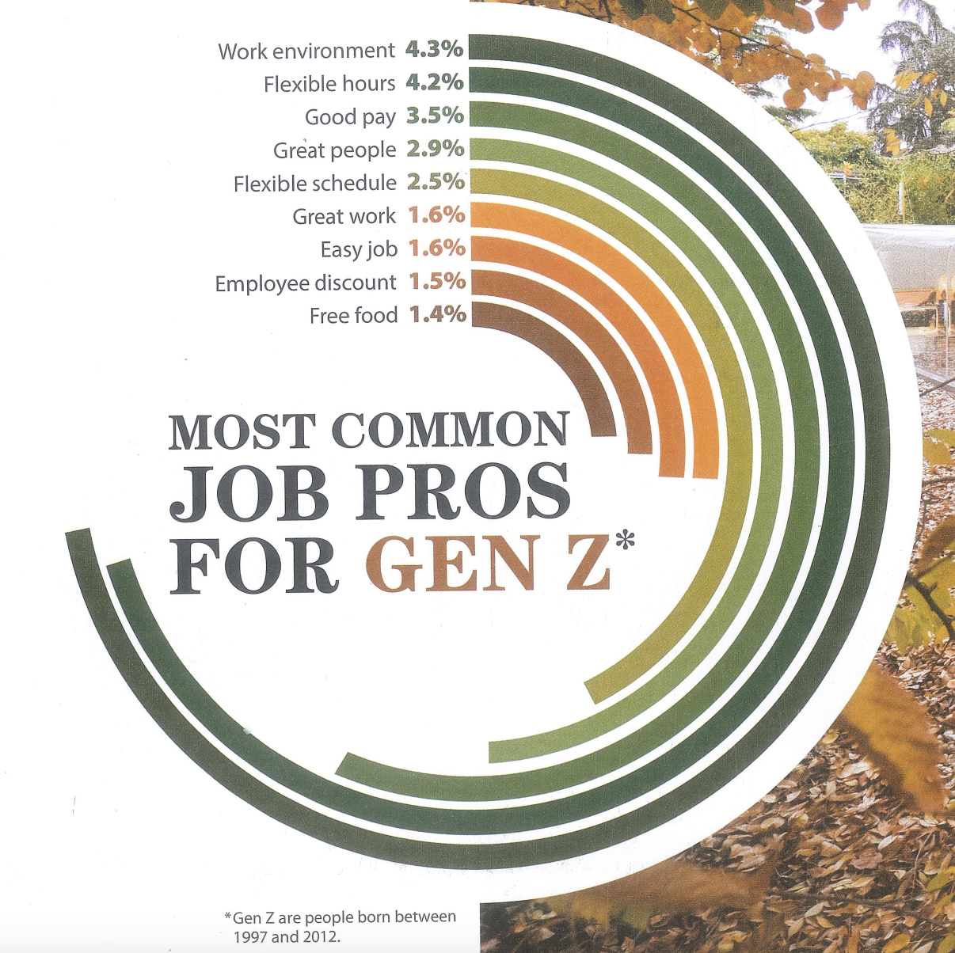
1. Which three job pros do Gen Z employees talk about the most?
2. Do you agree? What are your top three job pros?
3. What about job cons?
Page 3

Slide 10
The phrase “job pros” means the positive sides or advantages of a job.
The phrase “job cons” means the negative sides or disadvantages of a job.

Slide 11
👉 What are the job pros & cons of your current or future career?
job pros
work-life balance
Job security
Low stress levels
Good pay
personal growth
promotion
social benefits
Good working conditions
Good coworkers
job cons
Long working hours
Low salary or benefits
High stress levels
Limited career growth
Poor work-life balance
Unsafe or unhealthy working conditions
Job insecurity
Difficult/bad colleagues or management
Long Commute time
repetitive work
Competitive
Maintain creativity

Slide 12
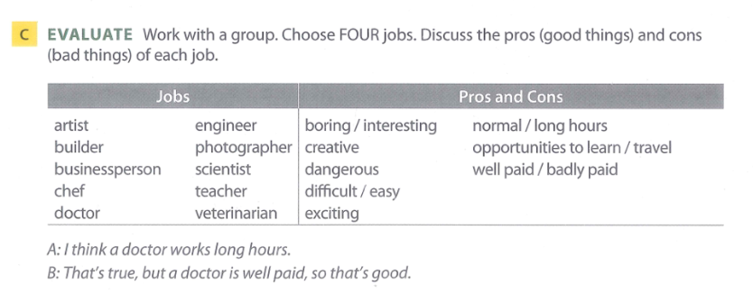
P.8

Slide 13
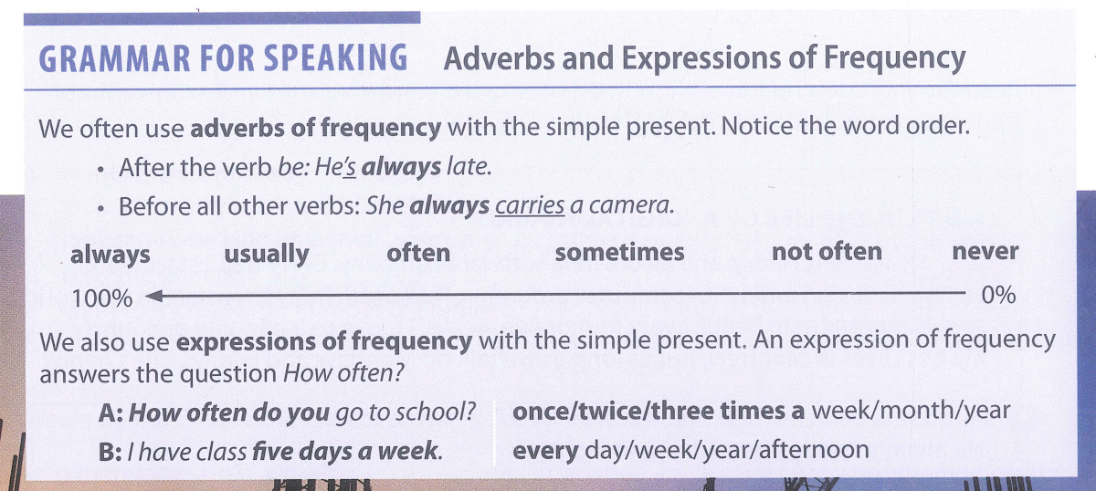
p9

Slide 14
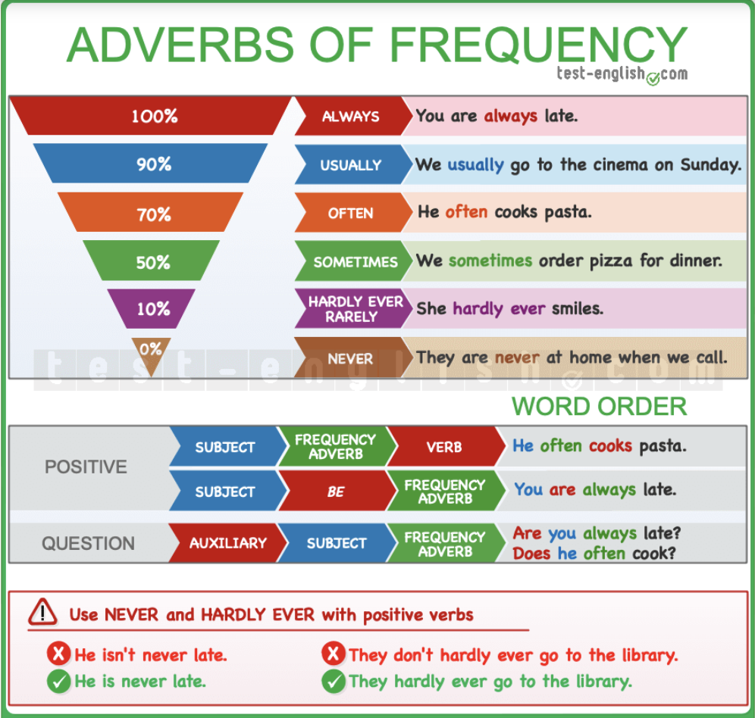

Slide 15
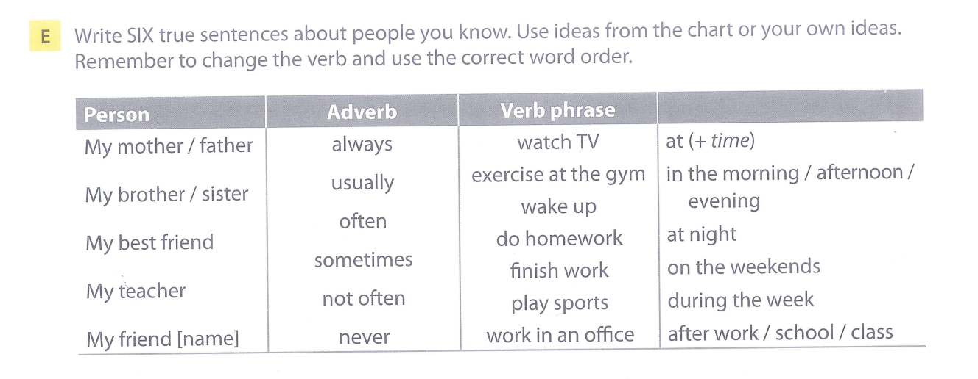

Slide 16
Speaking practice - Work in pair, ask & answer the question below about your current job
What is your job?
What do you usually do every day?
Do you often work with people or alone?
Do you sometimes work on weekends?
What do you like about your job?
What don’t you like about it?
Would you like to do this job forever? Why or why not?

Slide 17
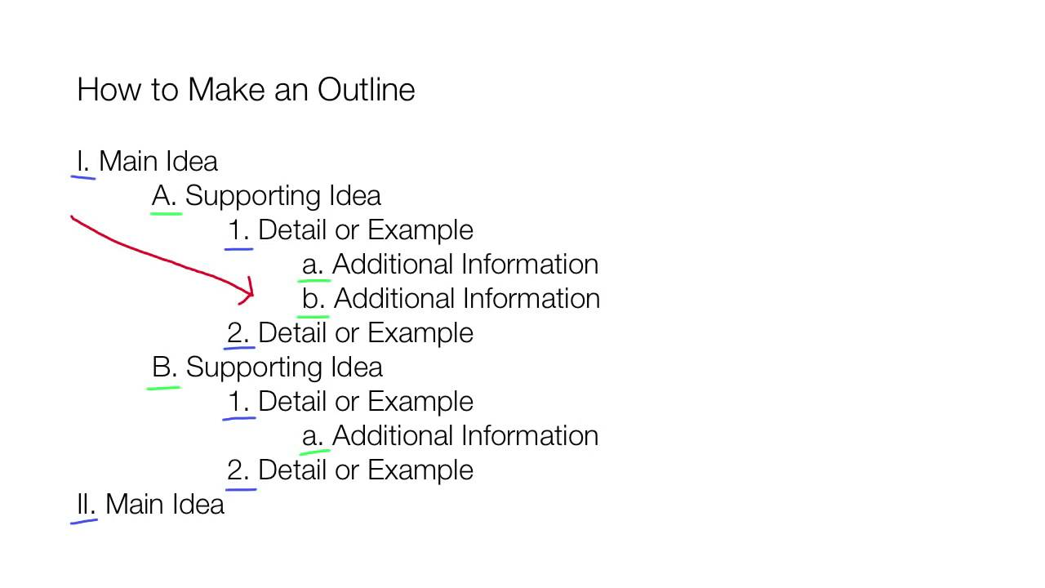

Slide 18
HW : Describe your dream job.
Make an outline of your dream job which includes the following information:
• Where you would work
• What special skills or qualifications you would need
• Whether you would work alone or with others
And explain why this job is important to you

Slide 19
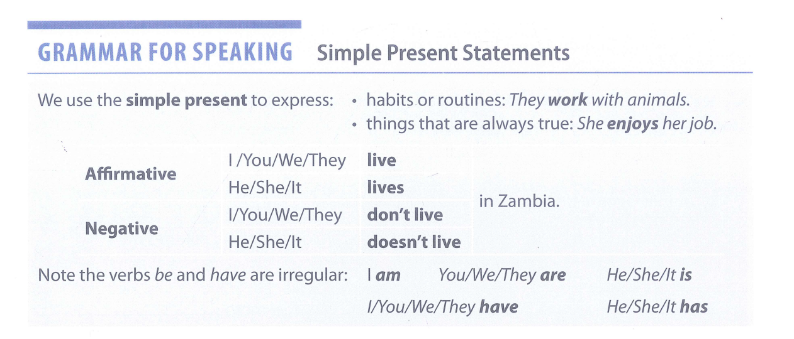

Slide 20
Complete these sentences about work. Use the simple present and contractions.
1. Explorers often ________to different places around the world. (travel)
2. My father is a doctor. He ________very long hours. (work)
3. I ________a lot of work, and I get long breaks. (not have)
4. My brother is a soldier. He ________ much vacation time in the army. (not get)
5. Waiters ________ good pay, but they sometimes get big tips. (not receive)
6. My aunt is an artist. She works long hours, but every day ________ different! (be)

Slide 21
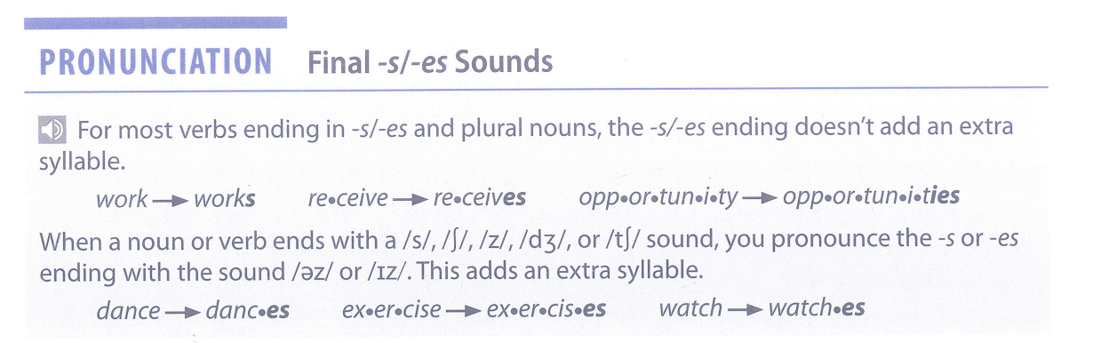

Slide 22
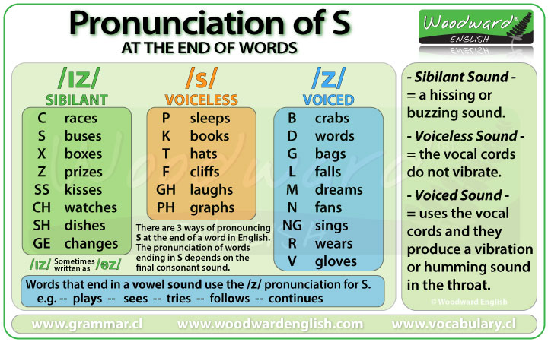
Notes:
https://www.youtube.com/watch?v=RUdVa9D_A6k&t=111s

